Slide 1
Behavioral Design Pattern
Instructor: Mehroze Khan

Slide 2
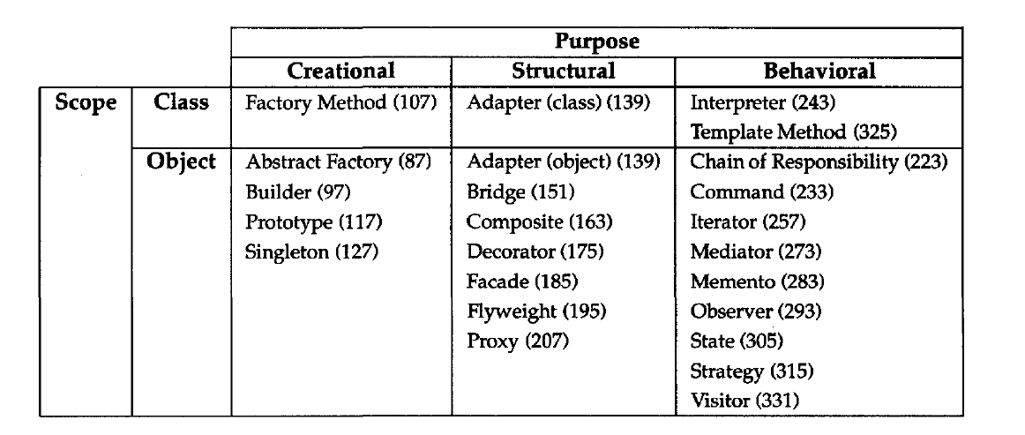
Behavioral Design Pattern
Behavioral design patterns are concerned with algorithms and the assignment of responsibilities between objects.
Behavioral patterns describe not just patterns of objects or classes but also the patterns of communication between them.

Slide 3
State Pattern

Slide 4
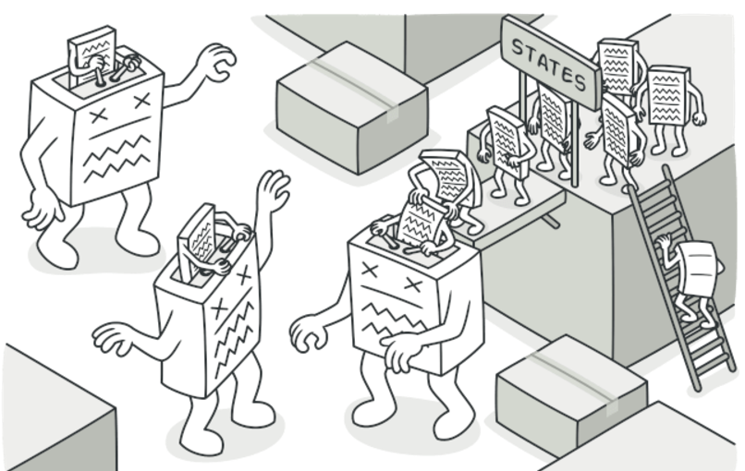
State Pattern
Intent:
State is a behavioral design pattern that lets an object alter its behavior when its internal state changes. It appears as if the object changed its class.

Slide 5
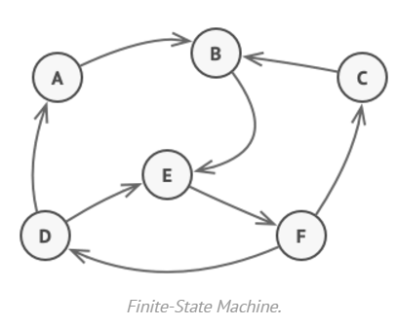
Problem
The State pattern is closely related to the concept of a Finite-State Machine.
At any given moment, there’s a finite number of states which a program can be in.
Within any unique state, the program behaves differently, and the program can be switched from one state to another instantaneously.
Depending on a current state, the program may or may not switch to certain other states.
These switching rules, called transitions, are also finite and predetermined.

Slide 6
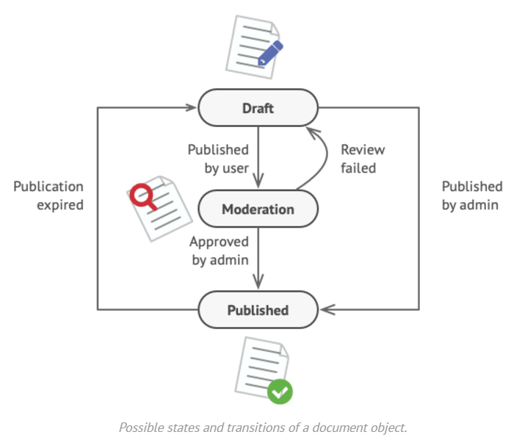
Problem
You can also apply this approach to objects. Imagine that we have a Document class.
A document can be in one of three states: Draft, Moderation and Published.
The publish method of the document works a little bit differently in each state:
In Draft, it moves the document to moderation.
In Moderation, it makes the document public, but only if the current user is an administrator.
In Published, it doesn’t do anything at all.

Slide 7
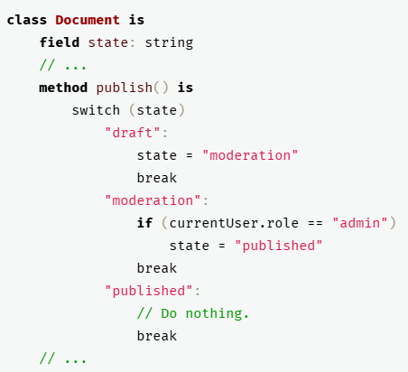
Problem
State machines are usually implemented with lots of conditional statements (if or switch) that select the appropriate behavior depending on the current state of the object.
Usually, this “state” is just a set of values of the object’s fields.
Most methods will contain monstrous conditionals that pick the proper behavior of a method according to the current state.
Code like this is very difficult to maintain because any change to the transition logic may require changing state conditionals in every method.

Slide 8
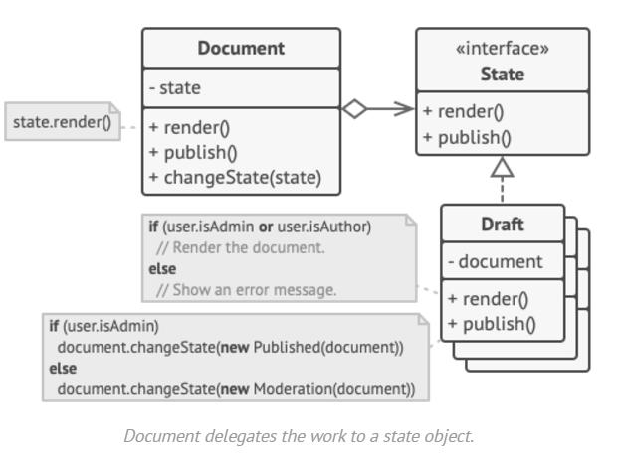
Solution
The State pattern suggests that you create new classes for all possible states of an object and extract all state-specific behaviors into these classes.
Instead of implementing all behaviors on its own, the original object, called context, stores a reference to one of the state objects that represents its current state, and delegates all the state-related work to that object.
To transition the context into another state, replace the active state object with another object that represents that new state. This is possible only if all state classes follow the same interface and the context itself works with these objects through that interface.

Slide 9
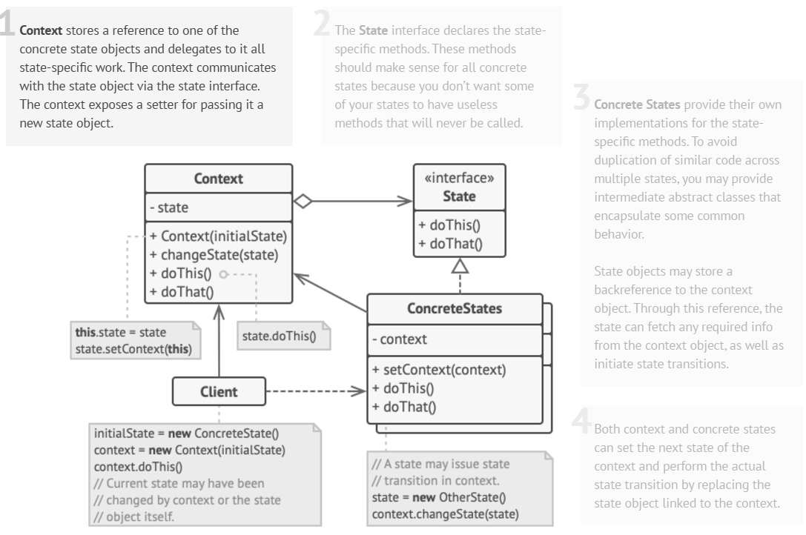
Structure

Slide 10
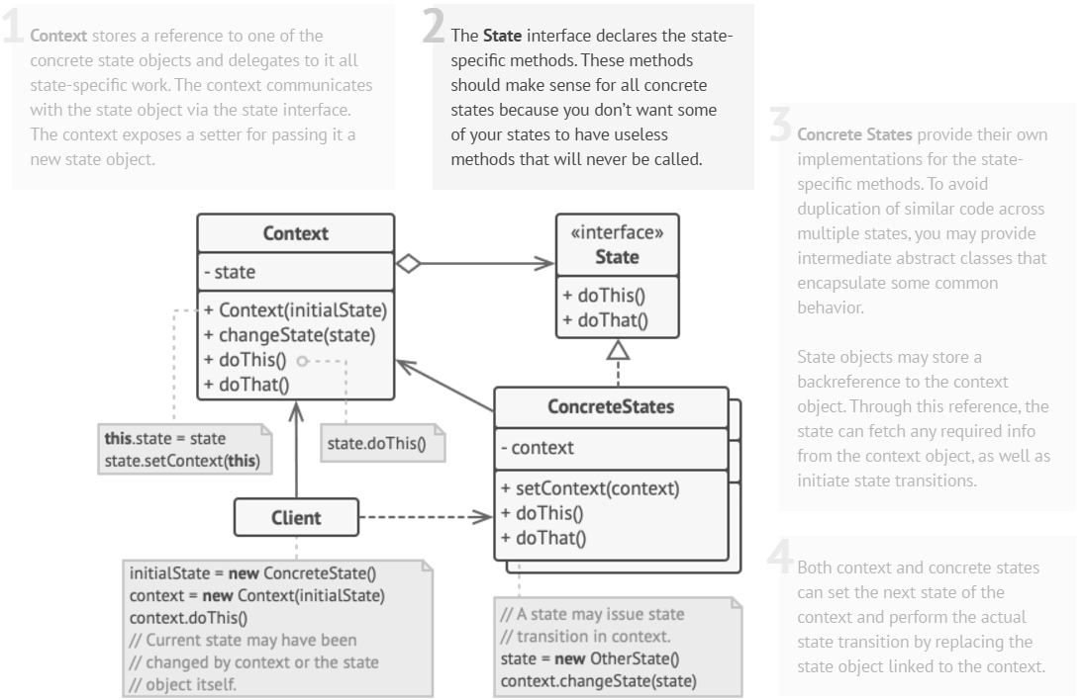
Structure

Slide 11
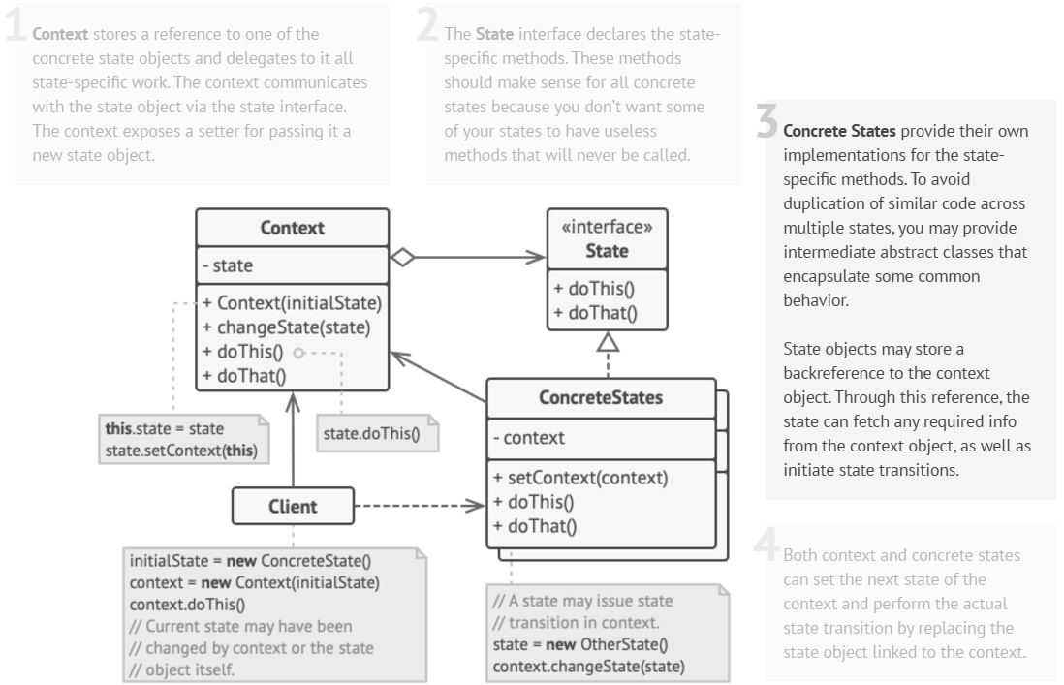
Structure

Slide 12
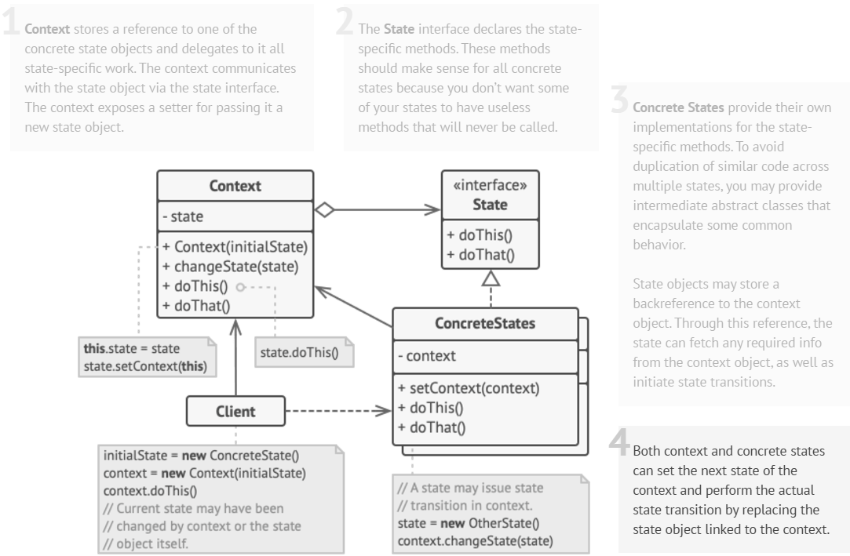
Structure

Slide 13
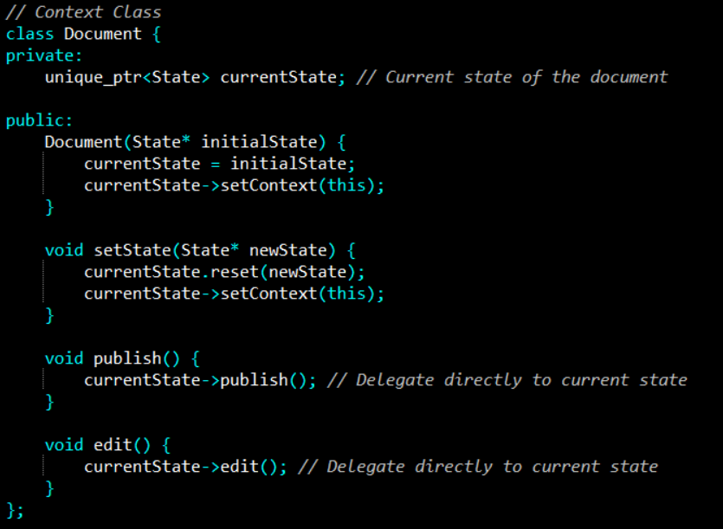
Example

Slide 14
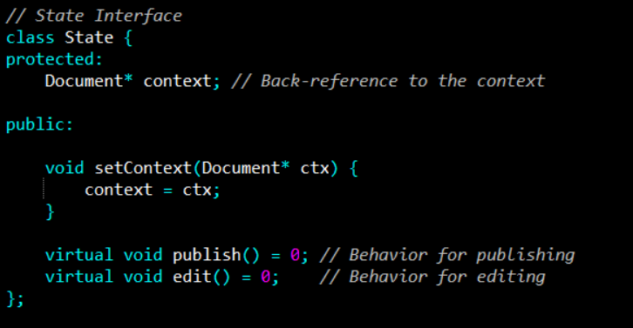
Example

Slide 15
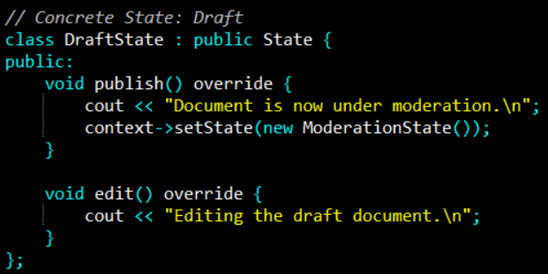
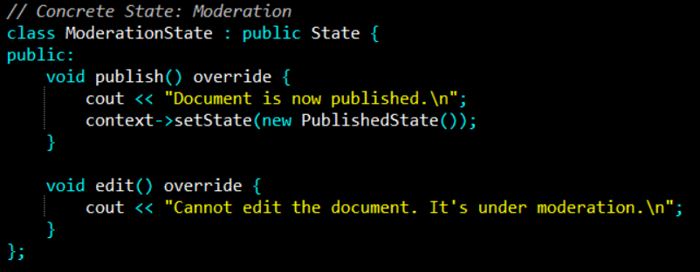
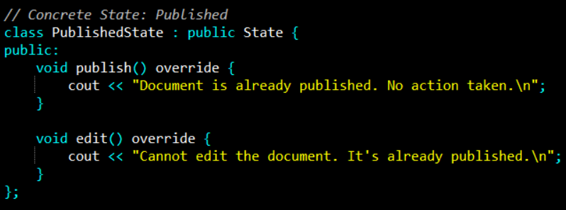
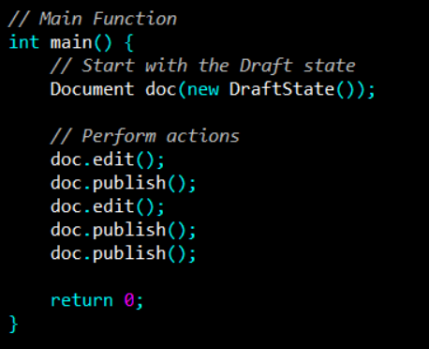
Example
Notes:
Output: Editing the draft document.
Document is now under moderation.
Cannot edit the document. It's under moderation.
Document is now published.
Document is already published. No action taken.

Slide 16
References
Design Patterns: Elements of Reusable Object-Oriented Software, Erich Gamma, Richard Helm, Ralph Johnson, and John Vlissides, Pearson, 1995.
Helping Links:
https://refactoring.guru/design-patterns/

